Slide 1




Supercharge computational drug discovery with AI-powered serverless high-performance computing (HPC)
Fengbo Ren,
Founder & CEO, Fovus

Slide 2
AI & HPC are playing vital roles in computational drug discovery
50-70% biotech companies
currently utilizing computational or AI methods in drug discovery
>200 startups
founded in recent years focused on AI-based drug discovery & development
20x higher computation usage
than engineering industries in terms of GPU- or core-hours on a per-user basis

Slide 3
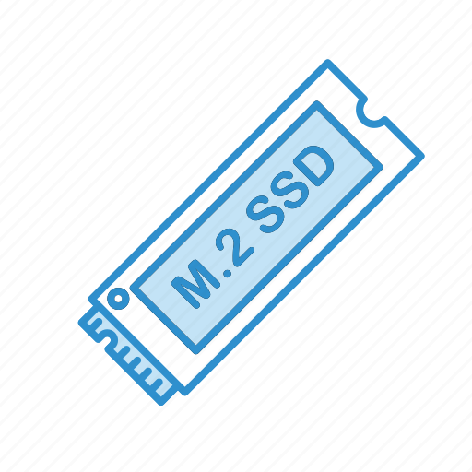





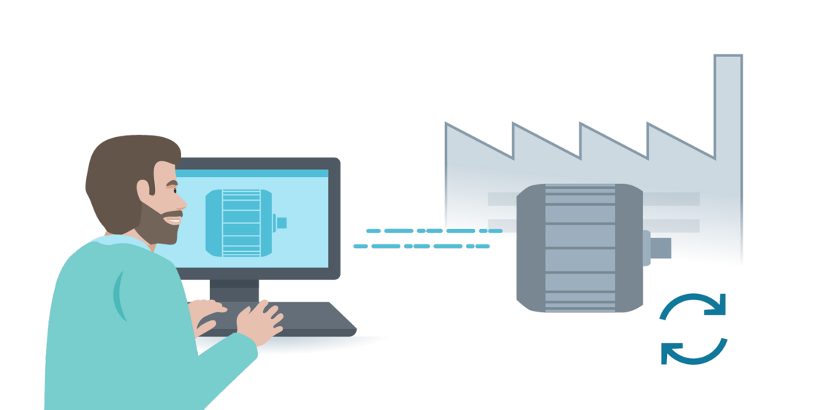
Benefits of cloud HPC
$
Low total cost of ownership
Low start-up capital
Timely infrastructure upgrade State-of-the-art hardware
High elasticity
Business agility
High accessibility availability & security Ideal support for remote working & collaboration

Slide 4



Cloud HPC challenges in drug discovery
High complexity
Slow, costly, hard to optimize
Hard to sustain optimality

Slide 5







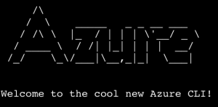





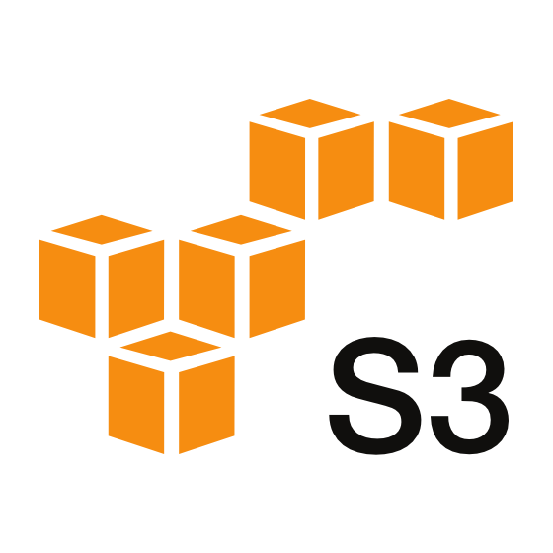



Challenges — 01 High complexity Managing the cloud is time-consuming & distracting. You want to spend valuable time on science & innovation.

Slide 6
Challenges — 02 Slow, costly, hard to optimize Cloud offerings are increasingly diverse & heterogeneous, making it arduous to find the optimal HPC strategy.
>750 instance types
on AWS with various compute, memory, and network config
Flexible storage, network architectures & provisioning choices
HPC Strategy Space
$
Optimal??
Time

Slide 7
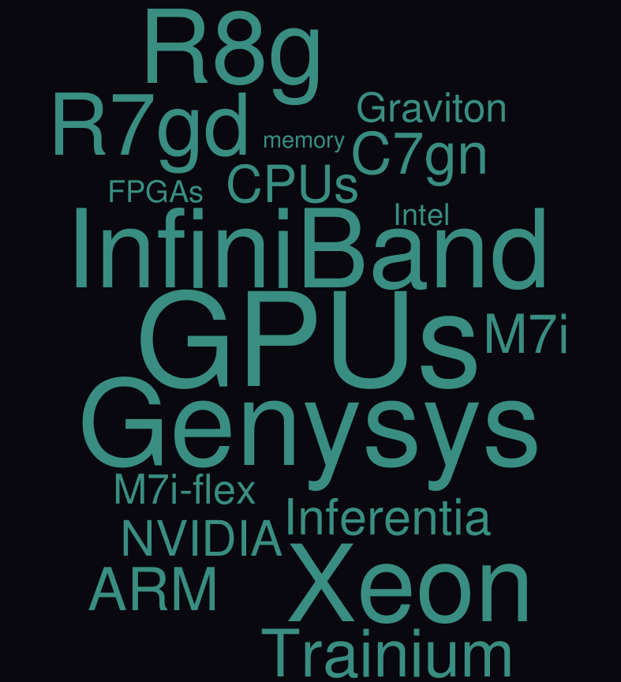
Challenges — 03 Hard to sustain optimality Fast-evolving cloud infrastructure & complex pricing dynamics make sustaining strategy optimality a constantly moving target.
61 new instance types
introduced on AWS in 2023
Every 18 months next-gen CPU, GPU, accelerator, memory, storage, & networking technology will be released

Slide 8







Fovus — AI-powered serverless HPC platform No more cloud hassles. Enjoy optimality & innovation efficiency.
Web
AI
optimize
HPC strategy
Full-stack automation
orchestrate logistics
Strategy
License
Workloads
Data
CLI
Workloads
Infrastructure
Data
Infrastructure
API
Use AI to auto-optimize HPC strategies & intelligently orchestrate cloud logistics to assure & sustain time-cost optimality.

Slide 9
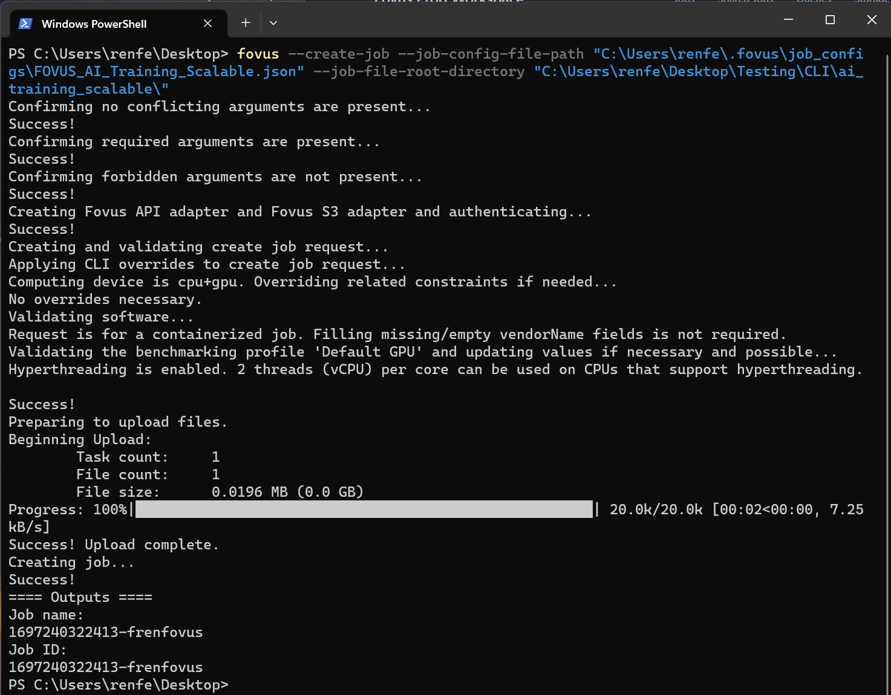
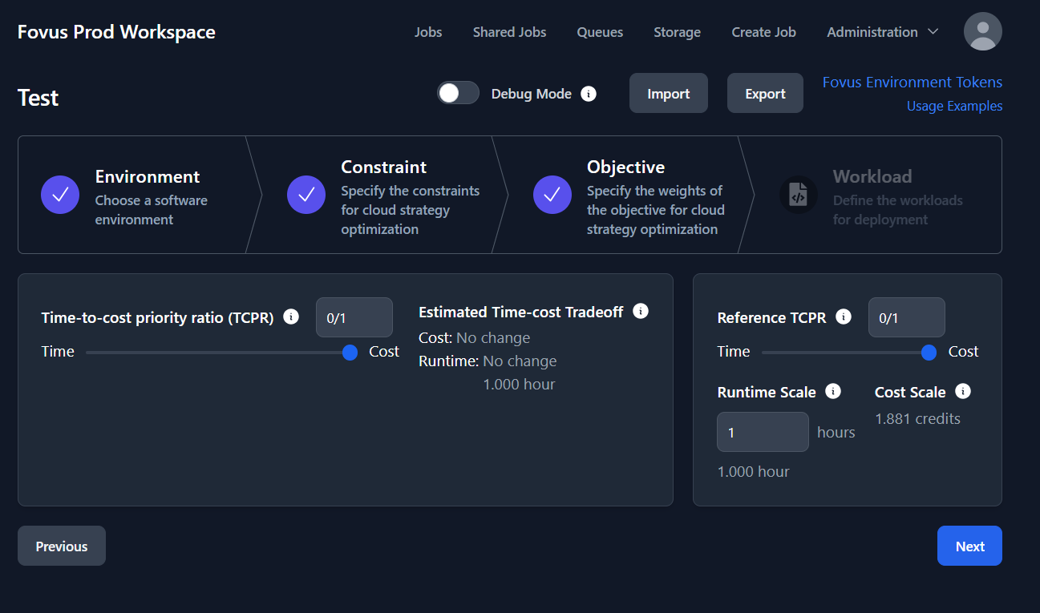
How It Works — 01 You Deploy Launch your HPC workloads in just a single command via CLI or only a few clicks via web UI.
CLI
Web UI

Slide 10
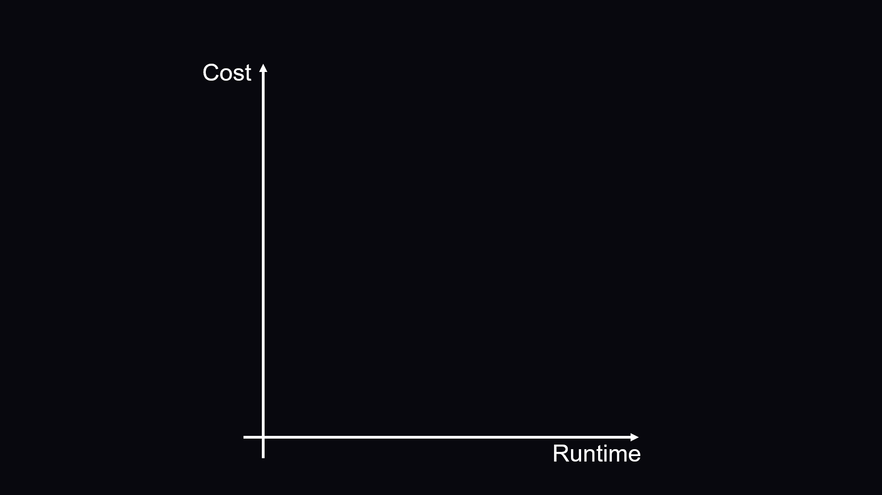
How It Works — 02 Fovus Optimizes a) We auto-benchmark your HPC workloads for free to effectively explore your HPC strategy space.

Slide 11
How It Works — 02 Fovus Optimizes b) We auto-determine the optimal HPC strategy for your workloads adaptively to minimize your runtime and cost.

Slide 12
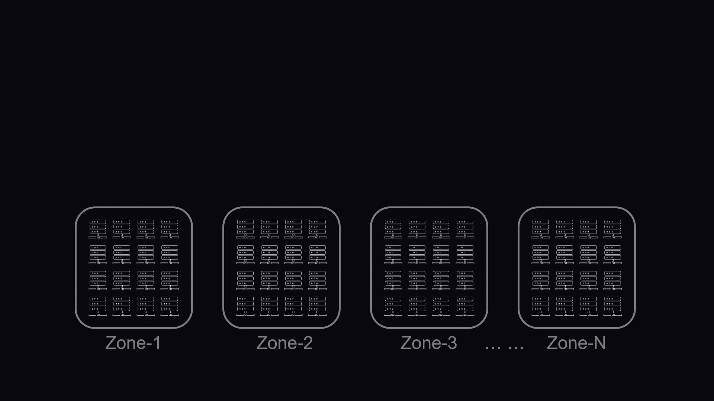
How It Works — 02 Fovus Optimizes e) For license-free workloads, we auto-scale them efficiently across multiple cloud zones/regions to further minimize your time-to-insight by 100X+.

Slide 13
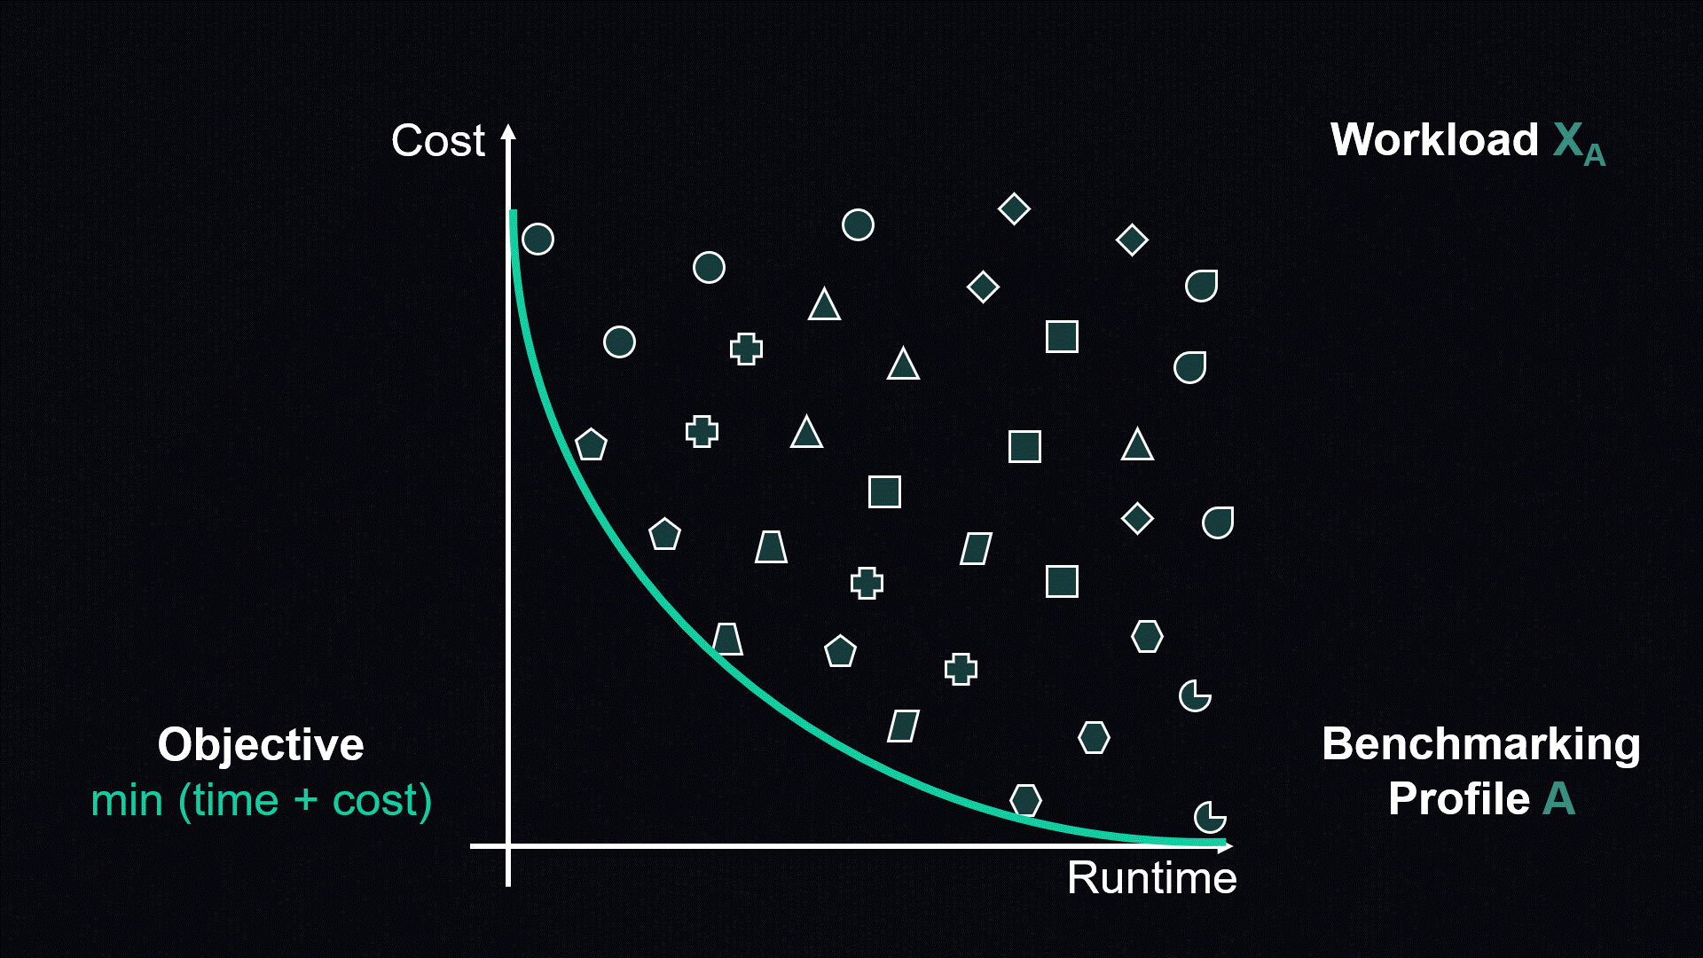
How It Works — 02 Fovus Optimizes f) We auto-leverage spot instances intelligently to slash your cloud cost by 2-7X further while assuring the integrity of results.

Slide 14
How It Works — 03 Fovus Continuously Improves We auto-update your benchmarking data & continuously improve your HPC strategy as hardware technology & cloud infrastructure quickly evolve.

Slide 15

Leading discovery service provider accelerated DMTA cycles and project delivery at reduced costs
Optimal
HPC strategy
Massive
task-level parallelism
Spot
instance auto-leveraged
112x
faster time-2-insight
85%
cloud cost saved
 | AWS Time | AWS Cost
Compound Screening (GROMACS Molecular Dynamics) | 4 weeks | $5,500
Fovus Time | Fovus Cost
6 hours | $750

Slide 16
Trailblazing biotech startup accelerated DMTA cycles at reduced cloud expense
Stealth Series-B Biotech Startup
Optimal
HPC strategy
Massive
task-level parallelism
Spot
instance auto-leveraged
4x
faster DMTA cycles
5.5x
lower
cloud cost
 | AWS Time | AWS Cost | Fovus Time | Fovus Cost | Time ↓ | Cost ↓
Docking | 45 hours | $3,250 | 3.5 hours | $650 | 13x | 5x
AI-accelerated Docking (Training) | 24 hours (local) | - | - | - | - | -
AI-accelerated Docking (Prediction) | 48 hours | $800 | 0.5 hours | $100 | 96x | 8x
Total (5 DMTA cycles) | 24 days | $20,250 | 6 days | $3,750 | 4x | 5.5x

Slide 17
GPU-accelerated GROMACS on Fovus Starting at $29/μs, as fast as 1139 ns/day
System | Atoms | ns/day | $/µs | ns/$
R-143a in hexane | 20,248 (small) | 83 – 374 | $73 - $336 | 3 - 13.6
RNA piece with explicit water | 31,889 (small) | 219 – 1139 | $29 - $102 | 9.8 - 34.9
Protein inside a membrane | 80,289 (medium) | 75 – 428 | $81 - $284 | 3.5 - 12.3
Protein in explicit water | 170,320 (medium) | 30 – 225 | $203 - $541 | 1.8 - 4.9
EAG1 membrane protein embedded in a lipid bilayer | 615,924 (large) | 8 – 65 | $755 - $1,870 | 0.5 - 1.3
STMV Virus Protein | 1,066,628 (large) | 4.5 - 38 | $1,350 - $3,032 | 0.3 - 0.7
Notes:
We’ve also done many case studies with commonly used computational tools in drug discovery. For Example GROMACS MD, In which, we let Fovus optimize HPC strategy and cloud usage, run these workloads with 3 different objective – minimize cost – cheapest strategy, minimize time – get fatest strategy to run it, and minimize both, get the best tradeoff between time and cost. Why you see a range. Results covery 3 different strategies. Many CC has the perception that GOMCAS can be very costly running on cloud GPUs, especially for large runs. With AI-powered servlerss HPC, here’s what you can achieve. See how does these numbers compare to your existing cost and performance. If your numbers is not close to this, that means you are not using the optimal strategy.

Slide 18
GPU-accelerated AlphaFold 3 on Fovus Saving up to 67% cost and 45% time
System | Atoms | Residues | Time/Fold (mins) | Cost/Fold | Time Saved | Cost Saved
Crystal structure of Mesothelin C-terminal peptide-MORAb 15B6 FAB complex | 3633 | 444 | 50 - 77 | $0.39 - $0.92 | 40% | 67%
Crystal structure of plant sesterterpene synthase AtTPS18 | 4676 | 554 | 33- 43 | $0.29 - $0.58 | 29% | 56%
Human PORCN in complex with LGK974 and WNT3A peptide | 5534 | 970 | 64 - 107 | $0.55 - $1.16 | 45% | 66%
Cryo-EM structure of human exostosin-like 3 (EXTL3) | 11236 | 1780 | 52 - 71 | $0.51 - $0.80 | 32% | 52%
Notes:
AF3. Most run on power GPUs like H100. That’s way overkill. $30 cents per fold

Slide 19

The value
1 day/week
100X+
5-10X
more time available to spend on discovery
Faster time to critical insights in DMTA cycles
Less cloud HPC expenses

Slide 20

Fovus — AI-powered serverless HPC platform
Intelligent, scalable, affordable supercomputing power at your fingertips
Supercharges your AI & computational drug discovery
Accelerates your DMTA cycles
Helps you achieve more with less
Get started today for a free trial with $100 credits and white-gloving onboarding
fovus.co

